Slide 1


IoC and Testability

Slide 2


Speaker
Paul Cowan
Cutting-Edge Solutions (Scotland)
dagda1@scotalt.net
http://the-software-simpleton.blogspot.com/

Slide 3
Agenda
What is Inversion Of Control?
Writng Testable code
IoC and Testability
Questions

Slide 4
What is Inversion
Of Control?

Slide 5
Problems with typical coding techniques
Glasgow ALT.NET User Group: http://tech.groups.yahoo.com/group/glasgow_altdotnet_usersgroup/

Slide 6
Tight Coupling
Notes:
Finish demo here.

Slide 7
The goals of good architecture
Don’t repeat yourself (DRY)
Separation of Concerns
Open, Closed Principle
Orthogonal Code
Favour Composition over Inheritance
Single Responsibility Pattern
Dependency Inversion Principle
Glasgow ALT.NET User Group: http://tech.groups.yahoo.com/group/glasgow_altdotnet_usersgroup/

Slide 8
What is Inversion
Of Control?

Slide 9
It is about the dependencies
Notes:
Finish demo here.

Slide 10
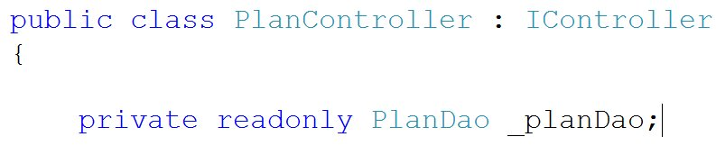
What is Inversion of Control?
Glasgow ALT.NET User Group: http://tech.groups.yahoo.com/group/glasgow_altdotnet_usersgroup/

Slide 11
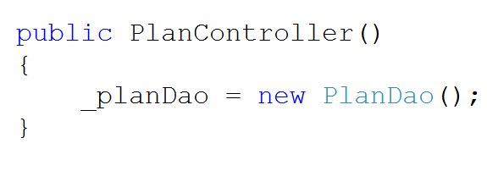
What is Inversion of Control?
PlanController is now coupled to the concrete instance of PlanDao
If PlanDao changes then the PlanController must change
Glasgow ALT.NET User Group: http://tech.groups.yahoo.com/group/glasgow_altdotnet_usersgroup/

Slide 12
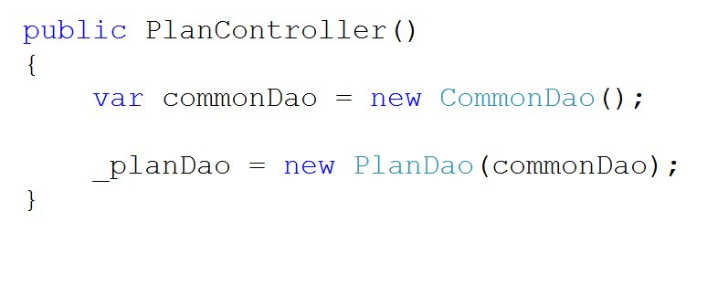
What is Inversion of Control?
The Design Of PlanDao has changed
This change is cascaded to the controller
Glasgow ALT.NET User Group: http://tech.groups.yahoo.com/group/glasgow_altdotnet_usersgroup/

Slide 13
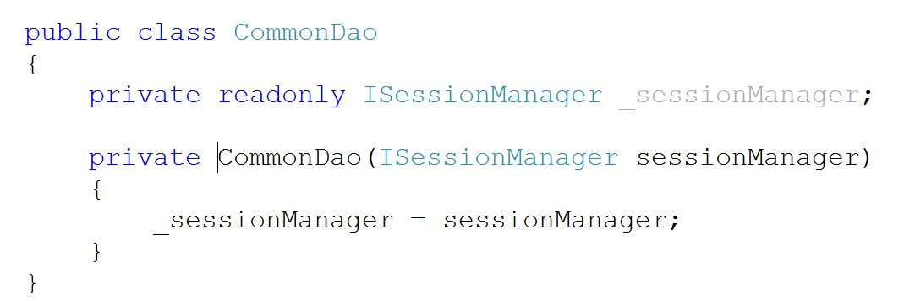
What is Inversion of Control?
CommonDao changes to include an Nhibernate specific instance
Glasgow ALT.NET User Group: http://tech.groups.yahoo.com/group/glasgow_altdotnet_usersgroup/

Slide 14
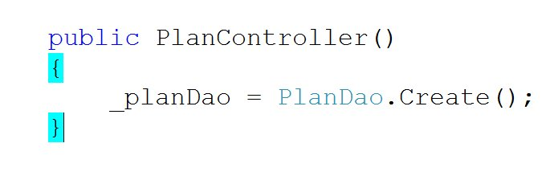
Factory Method Moves the problem
Factory method now creates the instance of PlanDao
Glasgow ALT.NET User Group: http://tech.groups.yahoo.com/group/glasgow_altdotnet_usersgroup/

Slide 15
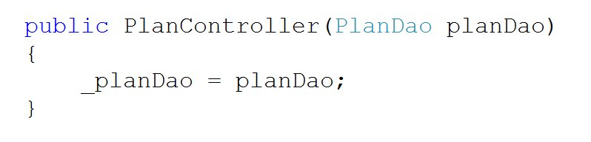
Simple Dependency Injection
Dependency is “injected” in.
The creation of the dependency is no longer the remit of the Controller.
Glasgow ALT.NET User Group: http://tech.groups.yahoo.com/group/glasgow_altdotnet_usersgroup/

Slide 16
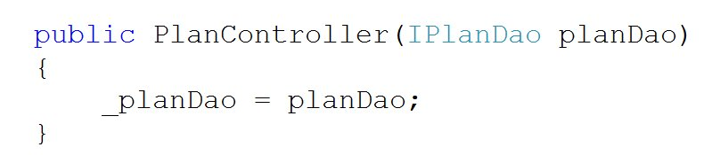
Depend On Absractions
We are now depending on an abstraction.
We can swap out implementations.
Glasgow ALT.NET User Group: http://tech.groups.yahoo.com/group/glasgow_altdotnet_usersgroup/

Slide 17
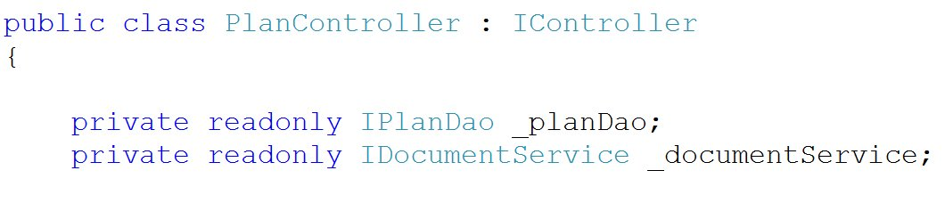
IoC in Action
We want to be easily able to bring new complex dependencies on board.
Glasgow ALT.NET User Group: http://tech.groups.yahoo.com/group/glasgow_altdotnet_usersgroup/

Slide 18
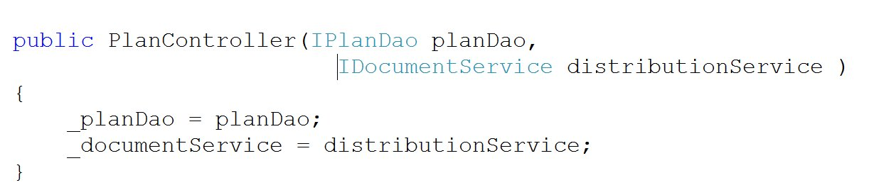
Easy Dependency Management
We simply state the dependency we require in the constructor and let the framework do the rest for us.
Glasgow ALT.NET User Group: http://tech.groups.yahoo.com/group/glasgow_altdotnet_usersgroup/

Slide 19
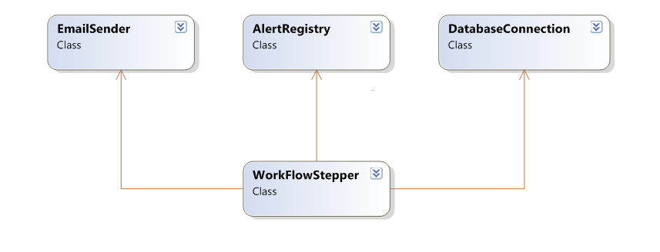
Component Driven Design
Glasgow ALT.NET User Group: http://tech.groups.yahoo.com/group/glasgow_altdotnet_usersgroup/

Slide 20
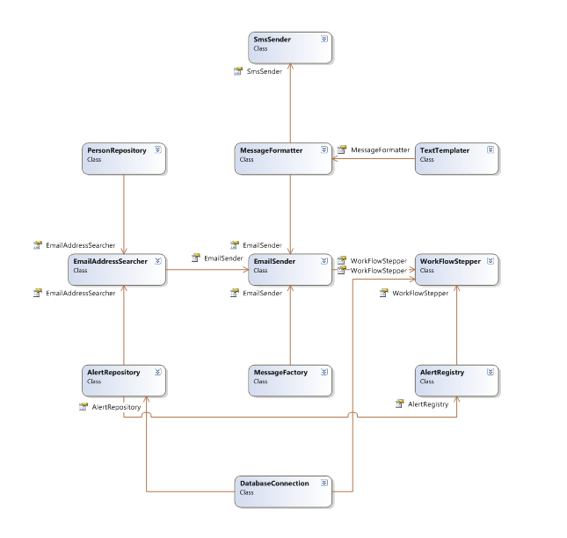

Slide 21
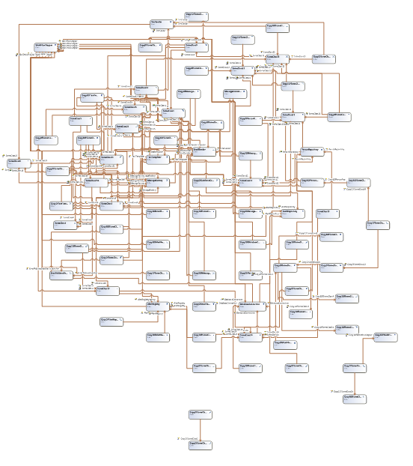

Slide 22
Inversion Of Control is.....
A way of designing reusable components
A way of decoupling services
The ability to ‘Inject’ dependencies through constructor or parameters (Dependency Injection)
Glasgow ALT.NET User Group: http://tech.groups.yahoo.com/group/glasgow_altdotnet_usersgroup/

Slide 23
Components
Components must be composable
A Independently deployable
Glasgow ALT.NET User Group: http://tech.groups.yahoo.com/group/glasgow_altdotnet_usersgroup/

Slide 24
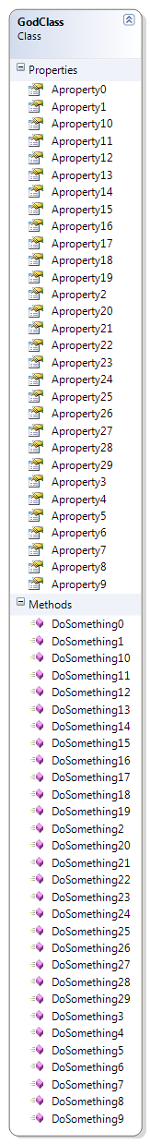
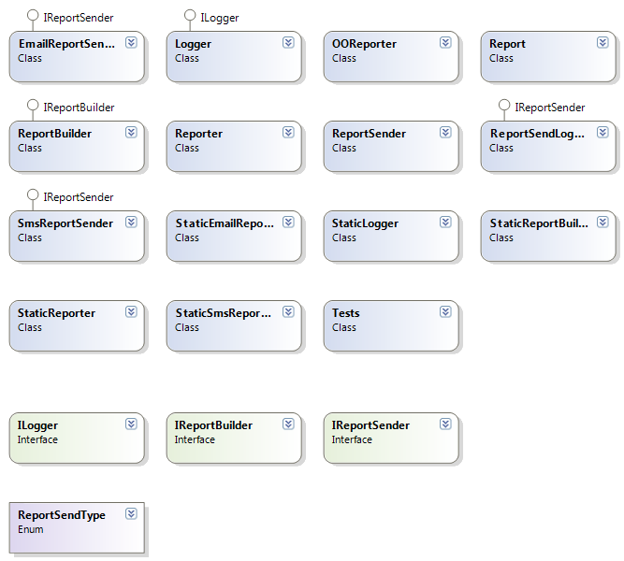
Break Large pieces into small
Glasgow ALT.NET User Group: http://tech.groups.yahoo.com/group/glasgow_altdotnet_usersgroup/

Slide 25
Show me the Code.
Notes:
Finish demo here.

Slide 26
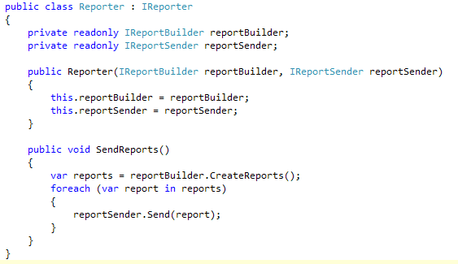
What is an IoC Container
Glasgow ALT.NET User Group: http://tech.groups.yahoo.com/group/glasgow_altdotnet_usersgroup/

Slide 27
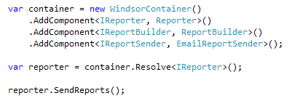
What is an IoC Container
Glasgow ALT.NET User Group: http://tech.groups.yahoo.com/group/glasgow_altdotnet_usersgroup/

Slide 28
What is an IoC Container
A (very) smart factory
Automatically resolves dependencies
Automatically injects concrete instances
All services are registered in the container
Single point of access for services
Transparent
Various implementations for .NET
Glasgow ALT.NET User Group: http://tech.groups.yahoo.com/group/glasgow_altdotnet_usersgroup/

Slide 29
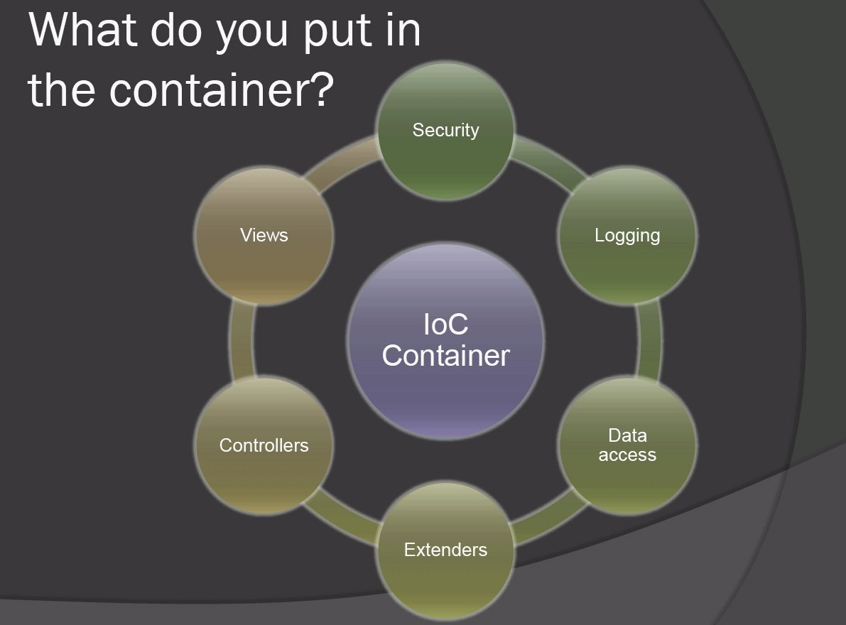
What is Invesion of Control?
Glasgow ALT.NET User Group: http://tech.groups.yahoo.com/group/glasgow_altdotnet_usersgroup/

Slide 30
Castle MicroKernel / Windsor
Part of the Castle Project castleproject.org
Started by Hamilton Verissimo
Also includes:
  MonoRail MVC framework for ASP.NET
  ActiveRecord based on NHibernate
Glasgow ALT.NET User Group: http://tech.groups.yahoo.com/group/glasgow_altdotnet_usersgroup/

Slide 31
Other Containers
Structuremap (http://structuremap.sourceforge.net/Default.htm)
Spring.NET (http://www.springframework.net/)
Autofac (http://code.google.com/p/autofac/)
Unity (http://codeplex.com/unity)
Glasgow ALT.NET User Group: http://tech.groups.yahoo.com/group/glasgow_altdotnet_usersgroup/
Glasgow ALT.NET User Group: http://tech.groups.yahoo.com/group/glasgow_altdotnet_usersgroup/

Slide 32
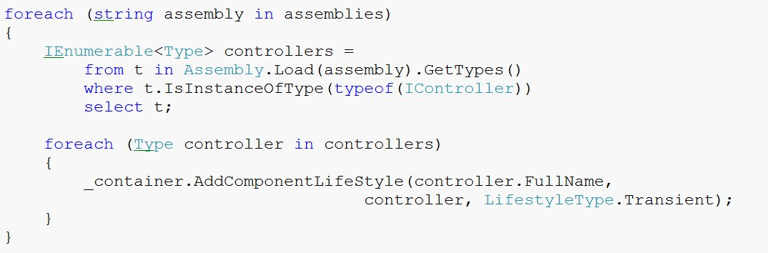
Auto-wiring Example
Glasgow ALT.NET User Group: http://tech.groups.yahoo.com/group/glasgow_altdotnet_usersgroup/

Slide 33
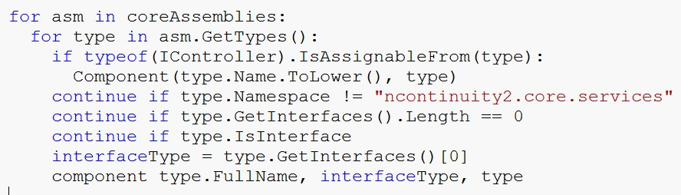
Binsor
Glasgow ALT.NET User Group: http://tech.groups.yahoo.com/group/glasgow_altdotnet_usersgroup/

Slide 34
Pros?
Simpler component architecture
Reduced cost of change
Easy to unit test
Easily move between application configurations
Glasgow ALT.NET User Group: http://tech.groups.yahoo.com/group/glasgow_altdotnet_usersgroup/

Slide 35
Cons?
Not another thing to learn?
Higher level of abstraction
Performance?
Maybe it’s time we looked at dynamically typed languages?
Glasgow ALT.NET User Group: http://tech.groups.yahoo.com/group/glasgow_altdotnet_usersgroup/

Slide 36
Should I use it?
Already familiar with OO principles and patterns?
Already writing unit tests?
Using a statically typed language?
If not, learn how to do these first
Don’t impose an IoC container on a team which can’t see its benefit
Glasgow ALT.NET User Group: http://tech.groups.yahoo.com/group/glasgow_altdotnet_usersgroup/

Slide 37
Advanced Usage
Facilities
Facilities supplement the IOC with a new technology
Transaction Facility
[Transaction(TransactionMode.RequiresNew)]
public CallTree MoveContact(Guid responderUid, Guid replacementUid)
{
}
NHibernate Facility
Interceptors
public void Intercept(IInvocation invocation)
{
MethodInfo methodInfo = invocation.MethodInvocationTarget;
if ((methodInfo == null) || (!_metaInfo.Contains(methodInfo)))
{
invocation.Proceed();
return;
}
Glasgow ALT.NET User Group: http://tech.groups.yahoo.com/group/glasgow_altdotnet_usersgroup/

Slide 38
Castle WCF Facility
Glasgow ALT.NET User Group: http://tech.groups.yahoo.com/group/glasgow_altdotnet_usersgroup/

Slide 39
You must use Auto-Wiring
Notes:
Finish demo here.

Slide 40
Test Driven Development

Slide 41
What is TDD
The purpose of the tests in TDD is to drive out the design of the system.
You write a test before writing the code in order to clarify in your mind what the code should do when you write it?
Glasgow ALT.NET User Group: http://tech.groups.yahoo.com/group/glasgow_altdotnet_usersgroup/

Slide 42
TDD Myths
Myth
Truth
It’s a QA technique
It’s a development approach
It’s a substitute to design & modelling,
traditional QA
Its orthogonal to design &
modelling traditional QA
It curtails productivity
Most who apply it consider it a
productivity technique but the
the jury is still out
Glasgow ALT.NET User Group: http://tech.groups.yahoo.com/group/glasgow_altdotnet_usersgroup/

Slide 43
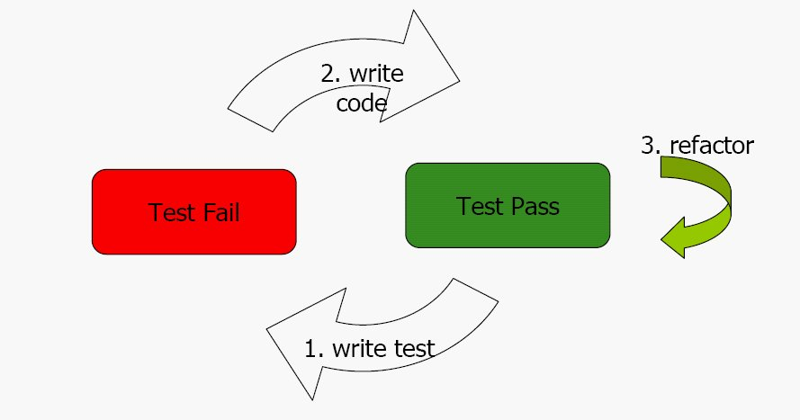
TDD Cycle
Glasgow ALT.NET User Group: http://tech.groups.yahoo.com/group/glasgow_altdotnet_usersgroup/

Slide 44
How to write good TDD specifications
What is the next important thing the system doesn’t do
Template for TDD scenarios
Given some initial context
When an event occurs
Then ensure some outcomes
Glasgow ALT.NET User Group: http://tech.groups.yahoo.com/group/glasgow_altdotnet_usersgroup/

Slide 45
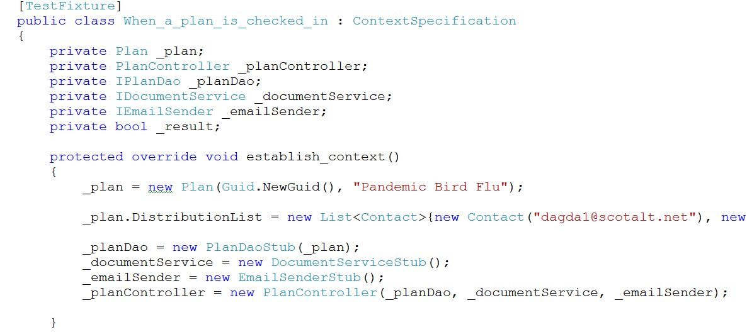
Example
Glasgow ALT.NET User Group: http://tech.groups.yahoo.com/group/glasgow_altdotnet_usersgroup/

Slide 46
Properties of a good unit test
They run fast
They run in isolation
They provide documentation in the form of examples of how to invoke components of the system.
They represent progress towards the solution
Glasgow ALT.NET User Group: http://tech.groups.yahoo.com/group/glasgow_altdotnet_usersgroup/

Slide 47
Pure Unit Tests
A test is not “pure” if it
Talks to the database
It communicates across the network
It touches the file system
All “pure" unit tests for a system can be run many times a day as part of the TDD cycle.
Glasgow ALT.NET User Group: http://tech.groups.yahoo.com/group/glasgow_altdotnet_usersgroup/

Slide 48
TDD Guidelines
If you cannot test code – change it so you can
Test first
Only one concrete class per test – MOCK THE REST
Glasgow ALT.NET User Group: http://tech.groups.yahoo.com/group/glasgow_altdotnet_usersgroup/

Slide 49
Mocking
Mock objects are simulated objects that mimic the behaviour of real objects in controlled ways.
Mocking is about decoupling the class being designed from its dependencies.
Glasgow ALT.NET User Group: http://tech.groups.yahoo.com/group/glasgow_altdotnet_usersgroup/

Slide 50
Rhino Mocks 3.5
Main feature of 3.5 is the AAA syntax
Arrange or set up the test scenario
Act or carry out the functionality
Assert that our expectations are true
Glasgow ALT.NET User Group: http://tech.groups.yahoo.com/group/glasgow_altdotnet_usersgroup/

Slide 51
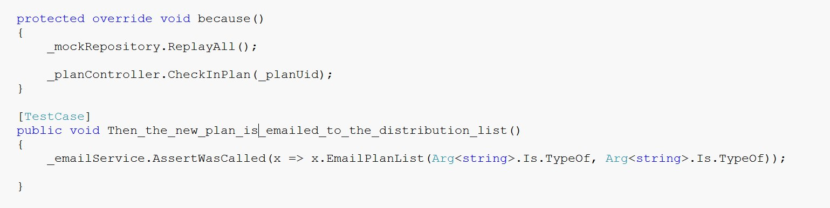
Example
Glasgow ALT.NET User Group: http://tech.groups.yahoo.com/group/glasgow_altdotnet_usersgroup/

Slide 52
TDD Encourages
DRY – Don’t repeat yourself
KISS – Keep It Simple Stupid
YAGNI – You Aint Going To Need It
SRP – Single Responsibility Pattern
IOC – Inversion Of Control
Glasgow ALT.NET User Group: http://tech.groups.yahoo.com/group/glasgow_altdotnet_usersgroup/

Slide 53
Epilogue

Slide 54
Any Questions ?

Slide 55


